Slide 1
CLC 5 Bucket and Radix sort
Ryan Coon
Allen Atkins
Carrie Assalone

Slide 2
Bucket Sort

Slide 3
Bucket sort or bin sort is a sorting algorithm that works by distributing the elements into a number of buckets, homogenously. Each bucket is then sorted individually. In order to sort the bucket, we use the sort() method of the Arrays class. It is usually used to sort floating-point numbers.
The basic idea to perform the bucket sort is:
Partition the range into a fixed number of buckets.
Toss each element into its appropriate bucket.
Sort each bucket individually using insertion sort.
Concatenate all the sorted buckets.

Slide 4
Pros:
It is asymptotically fast because of uniform distribution.
It reduces the number of comparisons.
It is fast in comparison to bubble sort.

Slide 5
Cons:
It is not an in-place sorting because we need some extra space to sort the buckets.
It may or may not be the stable sorting algorithm.
It is not useful if we have large array because it increases the cost.

Slide 6
bucketSort(arr[], n)
Create n empty buckets or lists.
Do the following for every array element arr[i].
A. Insert arr[i] into bucket[n*array[i]]
3. Sort individual buckets using insertion sort.
4. Concatenate all sorted buckets

Slide 7
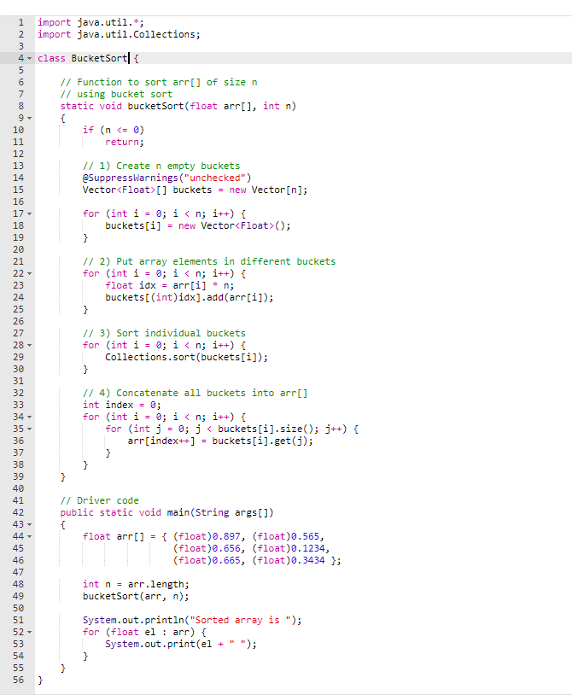

Time Complexity: If we assume that insertion in a bucket takes O(1)
time then steps 1 and 2 of the above algorithm clearly take O(n) time.
The O(1) is easily possible if we use a linked list to represent a bucket.
Step 4 also takes O(n) time as there will be n items in all buckets. The main step to analyze is step 3. This step also takes O(n) time
on average if all numbers are uniformly distributed

Slide 8
Radix Sort

Slide 9
Radix sort is the linear sorting algorithm that is used for integers. In Radix sort, there is digit by digit sorting is performed that is started from the least significant digit to the most significant digit.

Slide 10
The steps used in the sorting of radix sort are listed as follows:
First, we must find the largest element (suppose max) from the given array. Suppose 'x' be the number of digits in max. The 'x' is calculated because we need to go through the significant places of all elements.
After that, go through one by one each significant place. Here, we must use any stable sorting algorithm to sort the digits of each significant place.
Notes:
Code to run:
import java.io.*;
import java.util.*;
class Radix {
// A utility function to get maximum value in arr[]
static int getMax(int arr[], int n)
{
int mx = arr[0];
for (int i = 1; i < n; i++)
if (arr[i] > mx)
mx = arr[i];
return mx;
}
// A function to do counting sort of arr[] according to
// the digit represented by exp.
static void countSort(int arr[], int n, int exp)
{
int output[] = new int[n]; // output array
int i;
int count[] = new int[10];
Arrays.fill(count, 0);
// Store count of occurrences in count[]
for (i = 0; i < n; i++)
count[(arr[i] / exp) % 10]++;
// Change count[i] so that count[i] now contains
// actual position of this digit in output[]
for (i = 1; i < 10; i++)
count[i] += count[i - 1];
// Build the output array
for (i = n - 1; i >= 0; i--) {
output[count[(arr[i] / exp) % 10] - 1] = arr[i];
count[(arr[i] / exp) % 10]--;
}
// Copy the output array to arr[], so that arr[] now
// contains sorted numbers according to current digit
for (i = 0; i < n; i++)
arr[i] = output[i];
}
// The main function to that sorts arr[] of size n using
// Radix Sort
static void radixsort(int arr[], int n)
{
// Find the maximum number to know number of digits
int m = getMax(arr, n);
// Do counting sort for every digit. Note that
// instead of passing digit number, exp is passed.
// exp is 10^i where i is current digit number
for (int exp = 1; m / exp > 0; exp *= 10)
countSort(arr, n, exp);
}
// A utility function to print an array
static void print(int arr[], int n)
{
for (int i = 0; i < n; i++)
System.out.print(arr[i] + " ");
}
/*Driver Code*/
public static void main(String[] args)
{
int arr[] = { 170, 45, 75, 90, 802, 24, 2, 66 };
int n = arr.length;
// Function Call
radixsort(arr, n);
print(arr, n);
}
}

Slide 11
Time Complexity:
Let there be d digits in input integers. Radix Sort takes O(d*(n+b)) time where b is the base for representing numbers, for example, for the decimal system, b is 10. What is the value of d? If k is the maximum possible value, then d would be O(log_{b}(k)). So overall time complexity is O((n+b) * log_{b}(k)). Which looks more than the time complexity of comparison-based sorting algorithms for a large k. Let us first limit k. Let k <= n^{c} where c is a constant. In that case, the complexity becomes O(nLog_{b}(n)). But it still doesn’t beat comparison-based sorting algorithms.
What if we make the value of b larger?. What should be the value of b to make the time complexity linear? If we set b as n, we get the time complexity as O(n). In other words, we can sort an array of integers with a range from 1 to n^{c} if the numbers are represented in base n (or every digit takes log₂(n) bits).

